Slide 1


YOUDLE++
Sign Up Log In
Be great via Implicit learning
To make old traditional way of learning easier to absorb and interactive !
Lets get Started

Slide 2
YOUDLE++
Sign Up Log In
Create your Moodle++ account now
Use your Moodle email to sign up
First name
Surname
Email
Password
Confirm Password
Create

Slide 3
YOUDLE++
Sign Up Log In
Log in
Email
Password
Log in

Slide 4


YOUDLE++
Sign Up Log In
Create Quiz
Continue

Slide 5





YOUDLE++
Sign Up Log In
Insert Players
Add
Start!

Slide 6
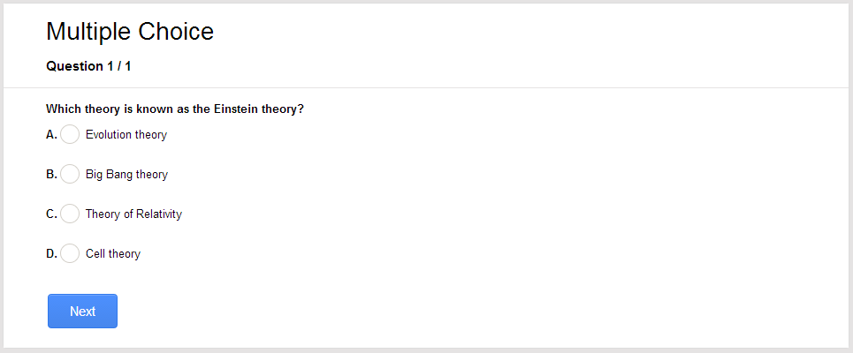
YOUDLE++
Sign Up Log In
Question 1/5

Slide 7
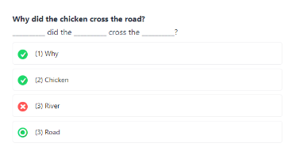
YOUDLE++
Sign Up Log In
Question 2/5

Slide 8
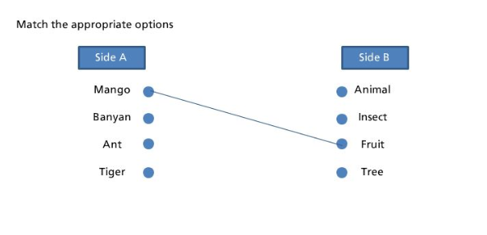
YOUDLE++
Sign Up Log In
Question 3/5

Slide 9
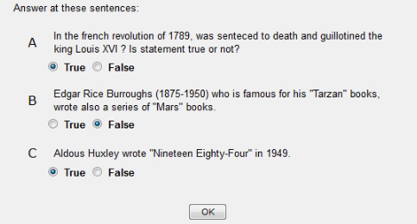
YOUDLE++
Sign Up Log In
Question 4/5

Slide 10
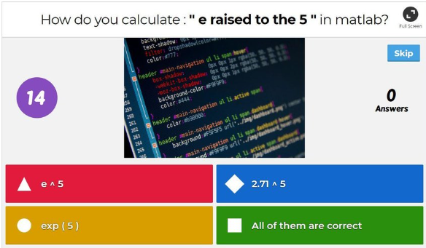
YOUDLE++
Sign Up Log In
Question 5/5

Slide 11
YOUDLE++
Sign Up Log In
Create Quiz
Continue

